Slide 1
Linking Latin Philosophical Expressions
Giovanna Tonazzo
Notes:
ID=d924773e-9a16-4d6d-9803-8cb819e99682 Recipe=text_billboard Type=TextOnly Variant=0 FamilyID=AccentBoxWalbaum_Zero

Slide 2
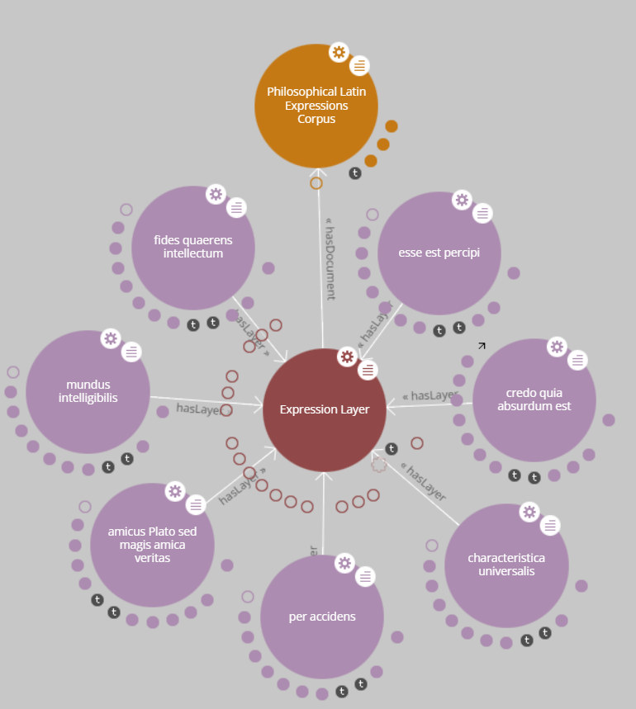
Agenda
Motivation
Methodology
Results
Data and code are available on GitHub

Slide 3
Motivation

Slide 4
The inspiration for this project is a collection of Latin (and Greek) philosophical expressions created by prof. James Lesher. Only the Latin expressions are considered here.
Each entry in the collection includes the literal translation, the linguistic analysis (e.g., parts of speech, cases), the philosophical meaning, often with examples from notable philosophers like Aristotle, Descartes, or Kant.
Examples of Latin expressions from the collection
A posteriori: preposition + the ablative neuter singular of the comparative adjective posterior/posteriorus (literally: ‘from the later thing’): things known a posteriori are known on the basis of experience (e.g. ‘We can know only a posteriori that all swans are white’).
A priori: preposition + the ablative neuter singular of the comparative adjective prior/prius (literally: ‘from the earlier thing’): what is known to be true a priori can be known independently of (or prior to) empirical investigation or confirmation (e.g. ‘Kant held that we can know a priori that a straight line is the shortest distance between two points.’)
Amicus Plato sed magis amica veritas: ‘Plato is a friend but truth is a greater friend’, based loosely on Aristotle, Nicomachean Ethics 1096a.

Slide 5
Can this resource be improved?
This resource is very useful for students, but is has some limitations:
It gives a short definition of each expression, but many of them have been interpreted in different ways by different thinkers. Expanding the entries to briefly indicate key philosophical interpretations would help student develop a critical understanding of concepts.
When philosophers are mentioned, it does not provide direct links or references to their works or biographical information. Adding these connections would make it easier for students to place the terms in their proper philosophical context.
Some entries are related (i.e “a priori” and “a posteriori”) but these relationships are not explicitly indicated in the document. Making these connections visible would help students understand the logical and conceptual relationships among terms.

Slide 6
Can this resource be improved?
This resource exists in a relatively isolated form. Publishing it as linked data by integrating it with existing ontologies or connecting entries to structured resources like Wikidata would significantly enrich its role as a resource for philosophical study.
This would allow students to situate each term within a broader conceptual and historical network, and to explore philosophical concepts across languages and interpretations more effectively.
Linking terms, expressions, and philosopher names to external sources would transform the resource from a static glossary into a dynamic, interoperable tool for philosophical study and research.

Slide 7
Methodology

Slide 8
Steps taken to enrich the resource (1)
Converted the original textual content into a structured format (CSV).
Added additional expressions (e.g., homo homini lupus); the final version is not fully aligned with Prof. Lesher’s original collection.
Provided more extensive definitions (with the help of ChatGPT) to clarify the general philosophical concepts.
Classified expressions by branch of philosophy (e.g., epistemology, ethics, logic).
Included alternative interpretations from different philosophers.

Slide 9
Steps taken to enrich the resource (2)
Linked expressions, philosophers, and philosophical branches to external resources (Wikidata).
Created internal links between related expressions (e.g., a priori and a posteriori, res cogitans and res extensa).
Performed grammatical analysis (part of speech, morphological features, dependency relations) following the Universal Dependencies framework.
Linked Latin lemmas to the LiLa “Linking Latin” knowledge base.
Published as linguistic linked data as triplestore in Turtle format

Slide 10
Tools used
OpenRefine for reconciliation with Wikidata page of entry, philosopher, branch of philosophy.
Python procedure to call LiLa TextLinker (see notebook).
Python procedure to call UDPipe API for annotation.
Python procedure using RdfLib to generate the triplestore (see notebook).
Apache Jena Fuseki and LodLive for visualization.
Basic SPARQL queries for analysis.

Slide 11
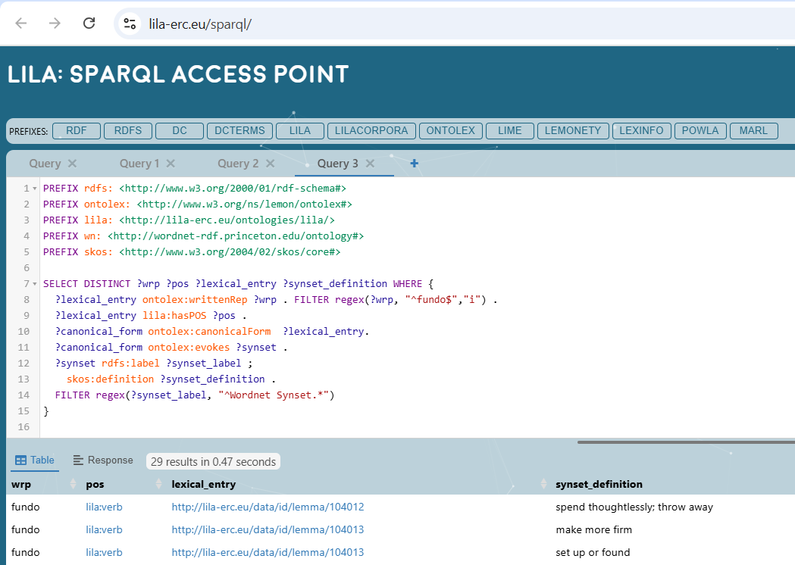
Linking to LiLa
Problems:
No matches: solved by manual search in Lemma Bank query interface
More than one match: ambiguity resolved with a SPARQL query to go from lemma to Wordnet synset to clarify meaning

Slide 12
Input data for Turtle file
CSV files for entries and interpretations
JSON file for LiLa links
Manually curated list of linked concepts
Response in CoNLL-U format returned by UDPipe (using model “latin-evalatin24-240520”)

Slide 13
Modeling
I considered the resource both as a corpus and as a lexical resource
Corpus
Modular approach: distinguish between content and annotation layer
Content:
Expressions belong to the “ExpressionLayer”
Tokens belong to the “DocumentLayer”
Each expression is a POWLA Root that belongs to the Expression Layer
The tokens are terminals in the Document Layer, they are linked to the root via the hasTerminal relation and to other tokens as prev, next
Syntax
Lemma feats deprel

Slide 14
Semantics
General concept modeled as LexicalConcept evoked by the lexical entry (both Latin and English lexical entry evoke the same concept)
The lexical concept has SKOS definition and link to wikidata page
Relations between expressions (a priori a posteriori) as relation between lexical concepts
Specific interpretations by different philosophers as different senses, linked to the general concept via SKOS narrower relation
Philosopher are connected to the sense as dc:creator of that particular interpretation
Branch of philosophy linked to lexical concept as broader concept
Translation
Relation between Latin and English lexical entries, reified, with category

Slide 15
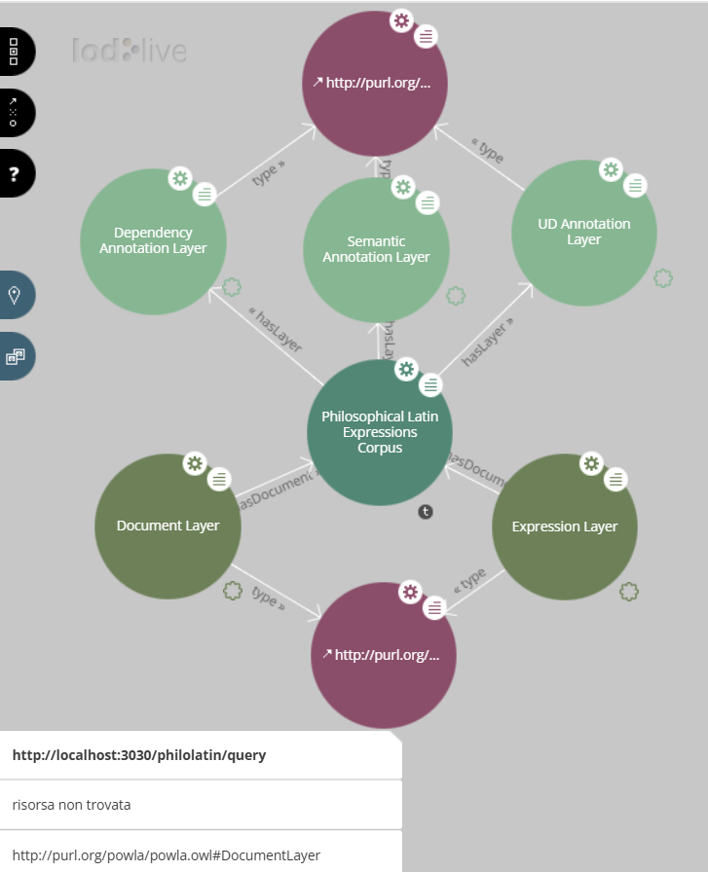
POWLA Corpus
Annotation Layers
Expression and Document Layers

Slide 16
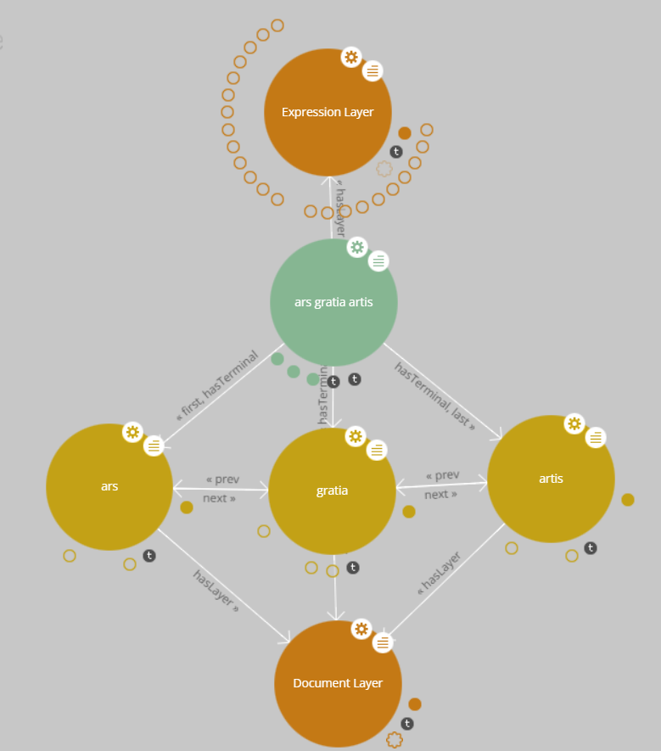
Content Layers
Expression Layer: expressions as POWLA roots
Document Layer: tokens as POWLA terminals, first - last
Links between tokens: prev- next

Slide 17
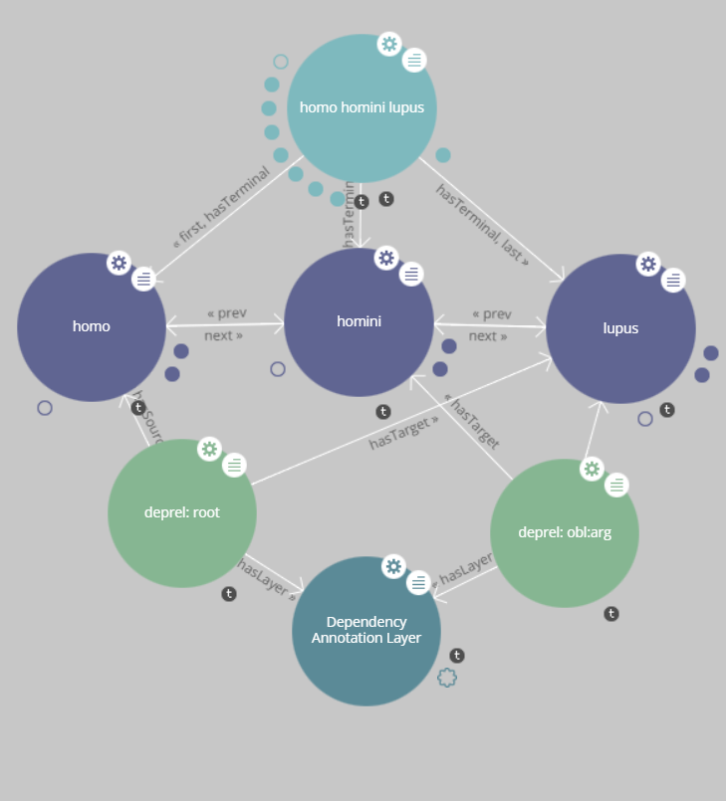
Syntax
Dependency Annotation Layer
Source, target, deprel

Slide 18
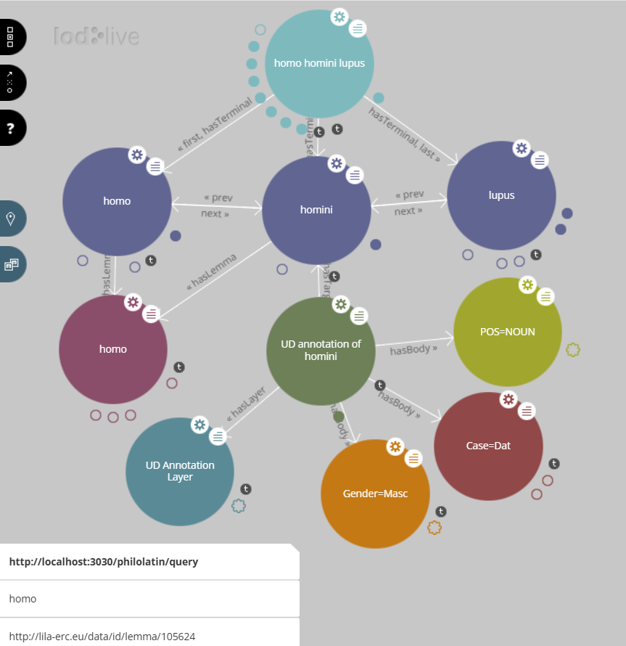
Syntax
UD Annotation Layer
POS and morphological features
Link to LiLa lemma

Slide 19
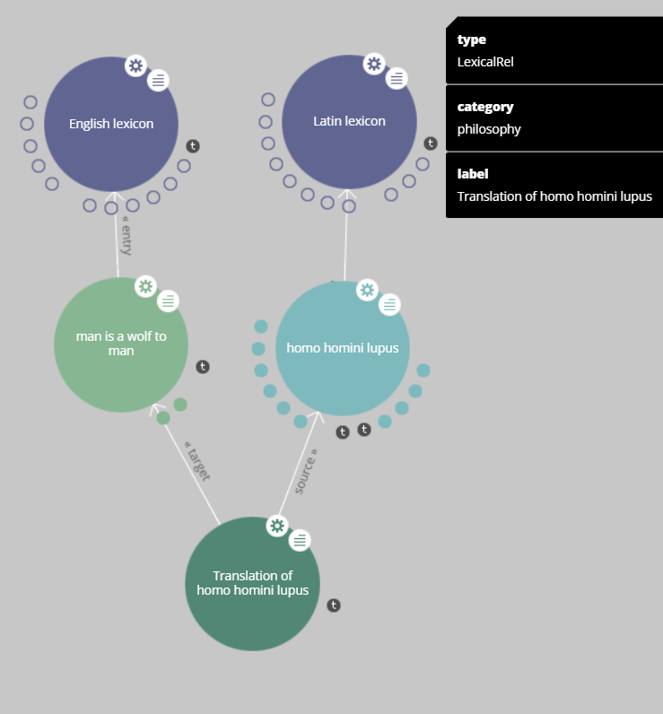
Ontolex
Each expression is a LexicalEntry of a lexicon
Latin lexicon and English lexicon
Translation as LexicalRel between lexical entries
Translation is reified and it is of category “philosophy”

Slide 20
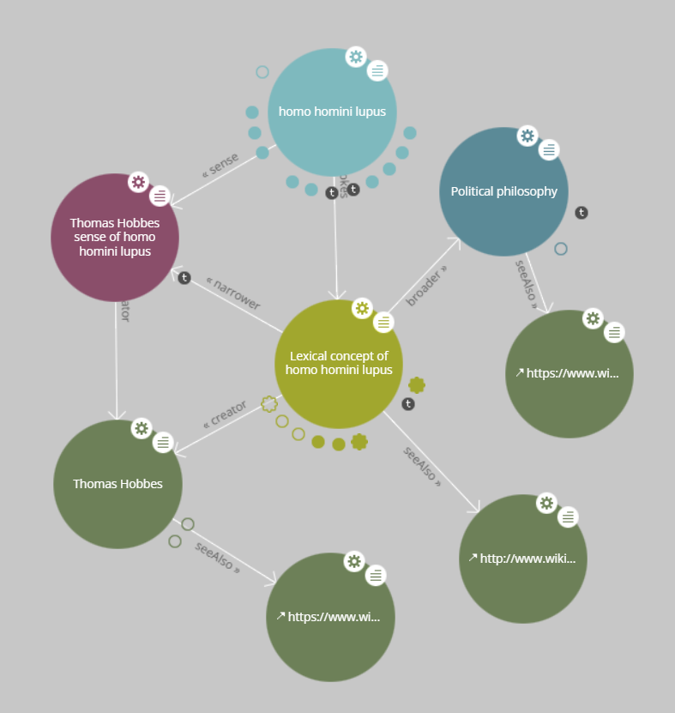
Semantics
Lexical Entry evokes a Lexical Concept
Branch of philosophy as broader concept
Links to entry, philosopher and branch in Wikidata
Interpretations by philosophers are lexical senses

Slide 21
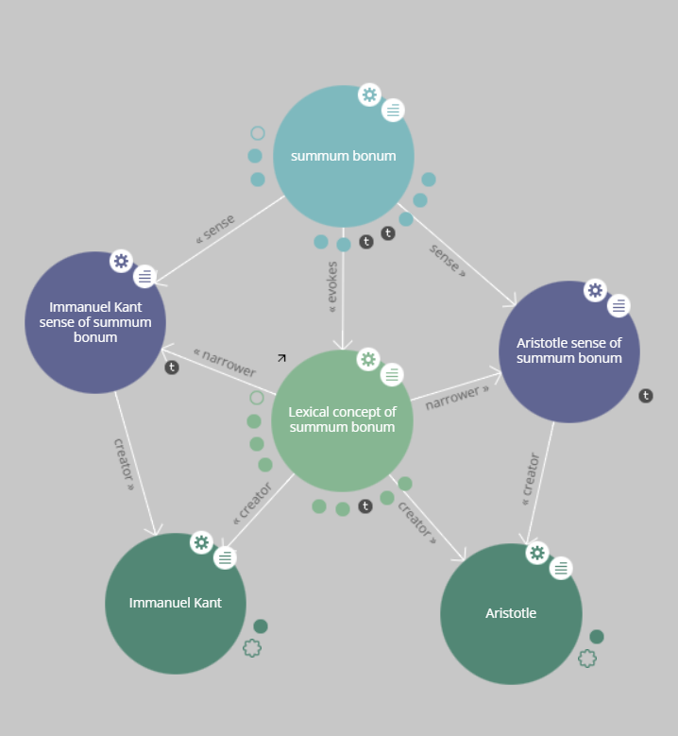
Interpretations
Different intepretations by philosophers as lexical senses
Narrower concepts of lexical concept
Philosopher as dc:creator

Slide 22
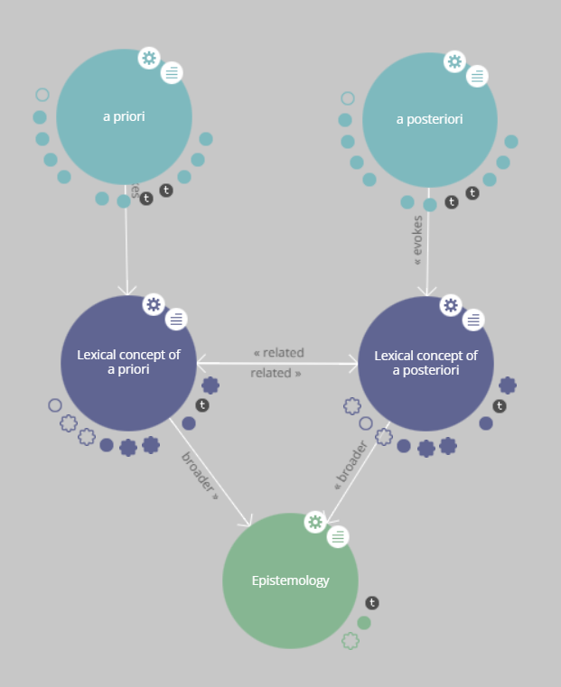
Related concepts
SKOS:realted

Slide 23
Results

Slide 24
Table
 | # | Category 4
Number of triples | 1.7 | 5
Number of Latin expressions | 4.4 | 3
Number of philosophers | 2.5 | 2.8
Number of senses | 1.7 | 7

Slide 25
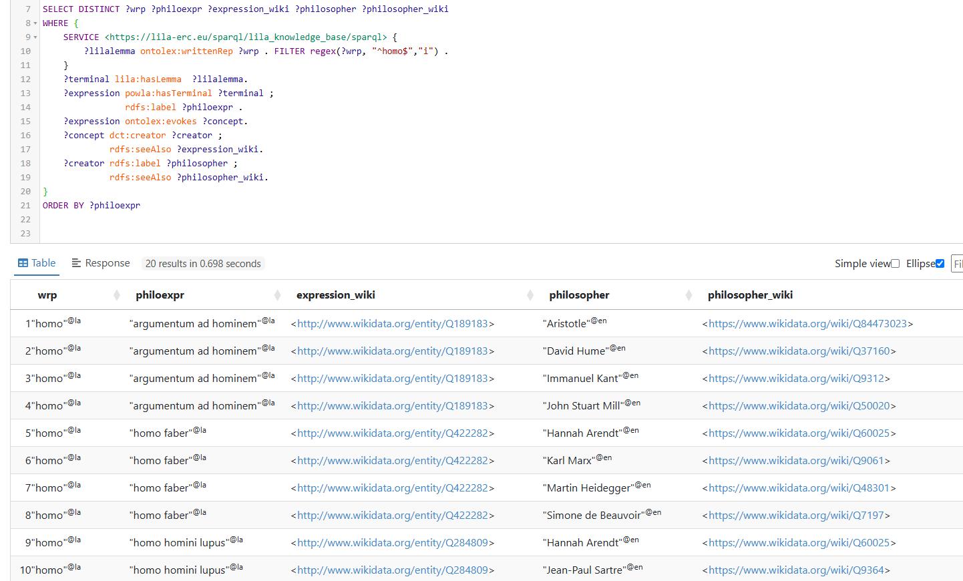
From LiLa to philosophy

Slide 26
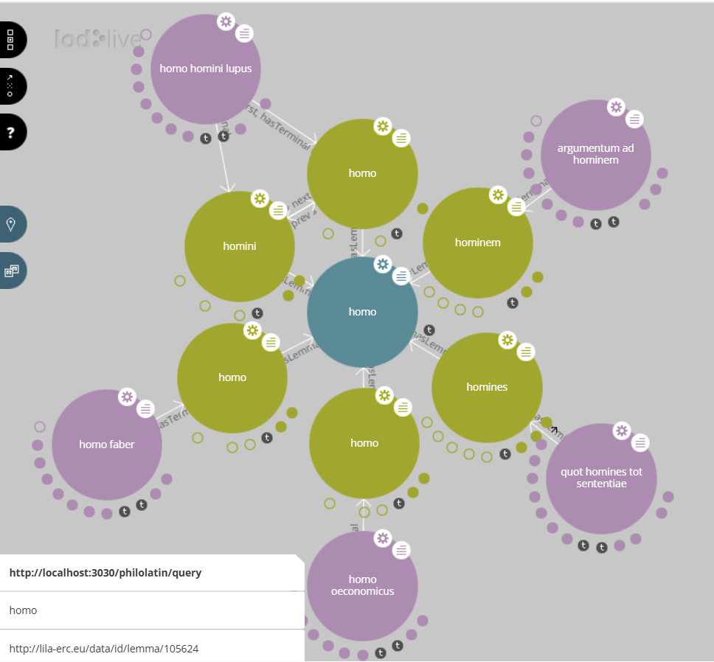
Expressions containing lemma “homo”

Slide 27
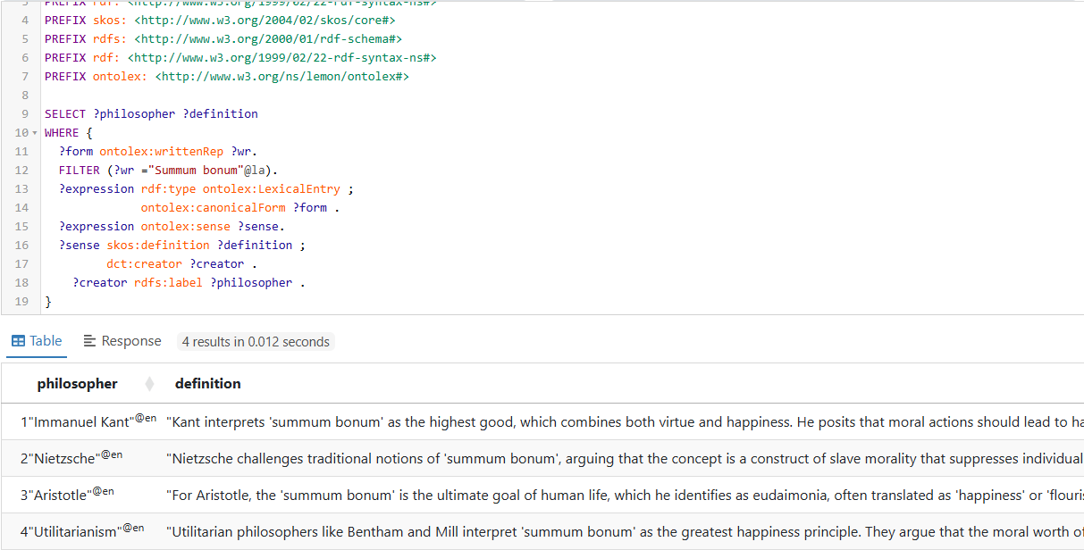
Interpretations of “Summum bonum”

Slide 28
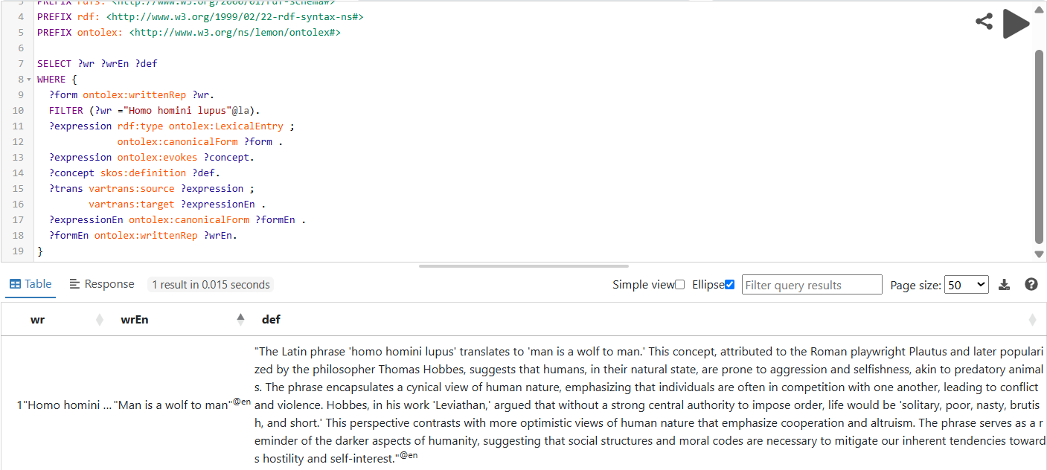
Translation and definition of “Homo homini lupus”

Slide 29
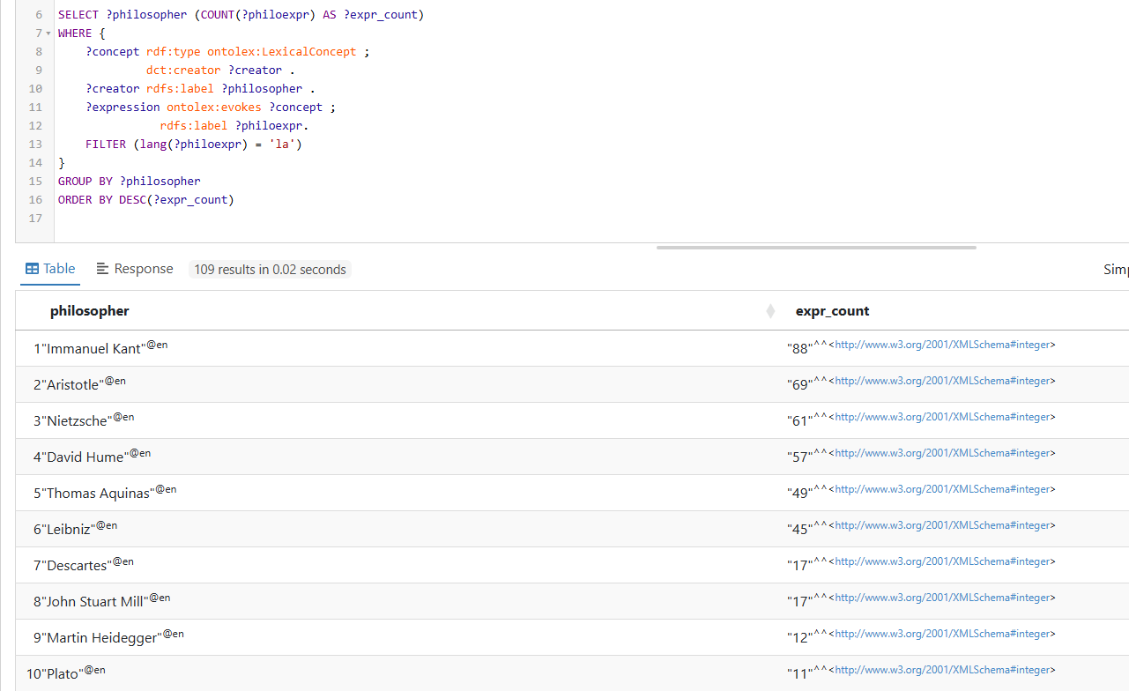
Philosophers connected to most expressions

Slide 30
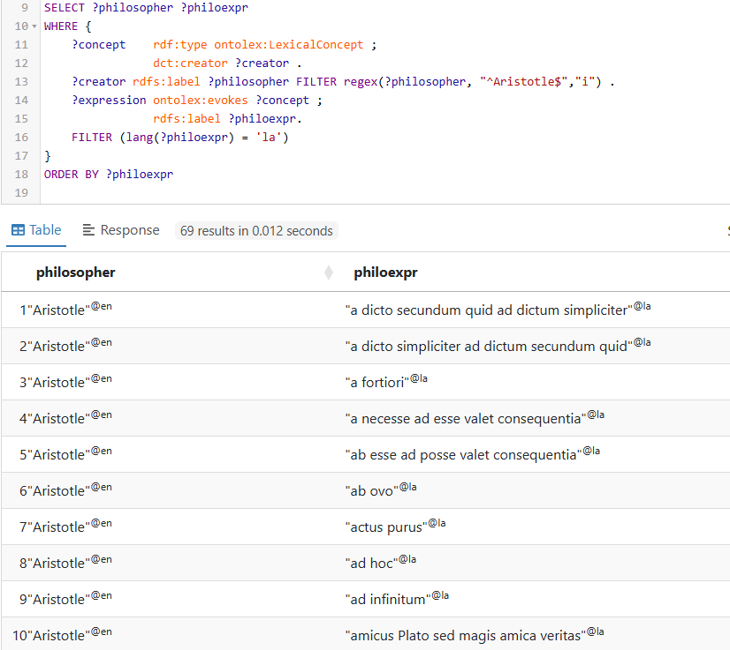
Expressions connected to Aristotle

Slide 31
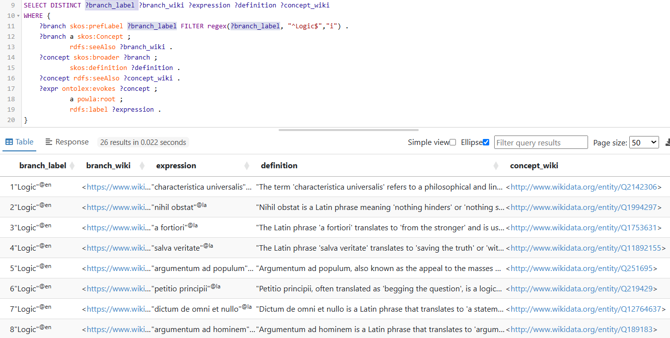
Expressions belonging to “Logic”

Slide 32
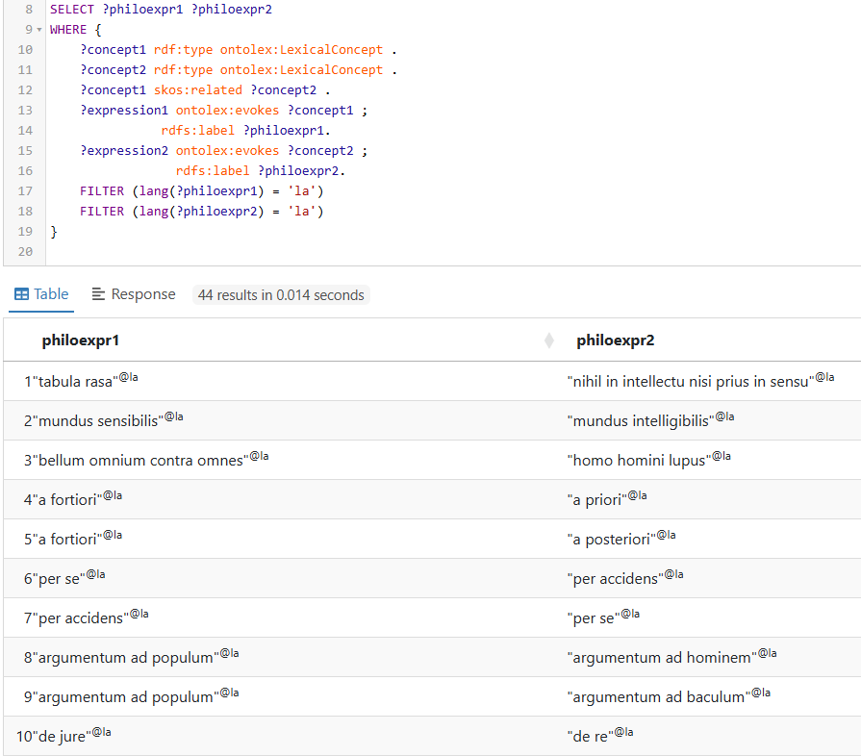
Linked concepts

Slide 33
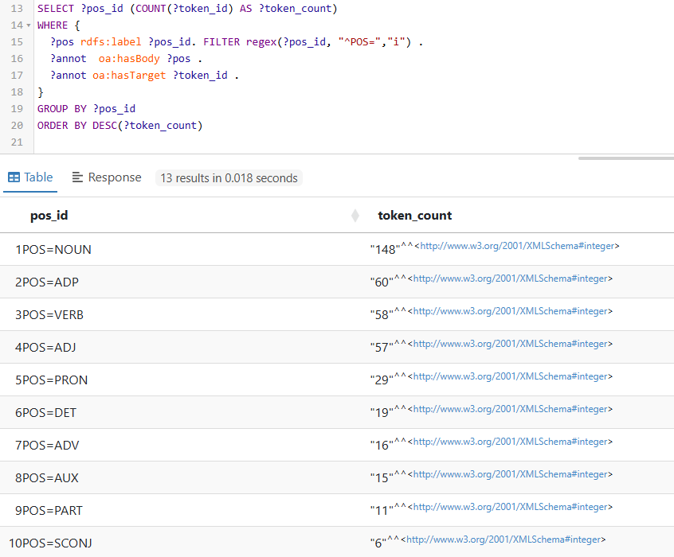
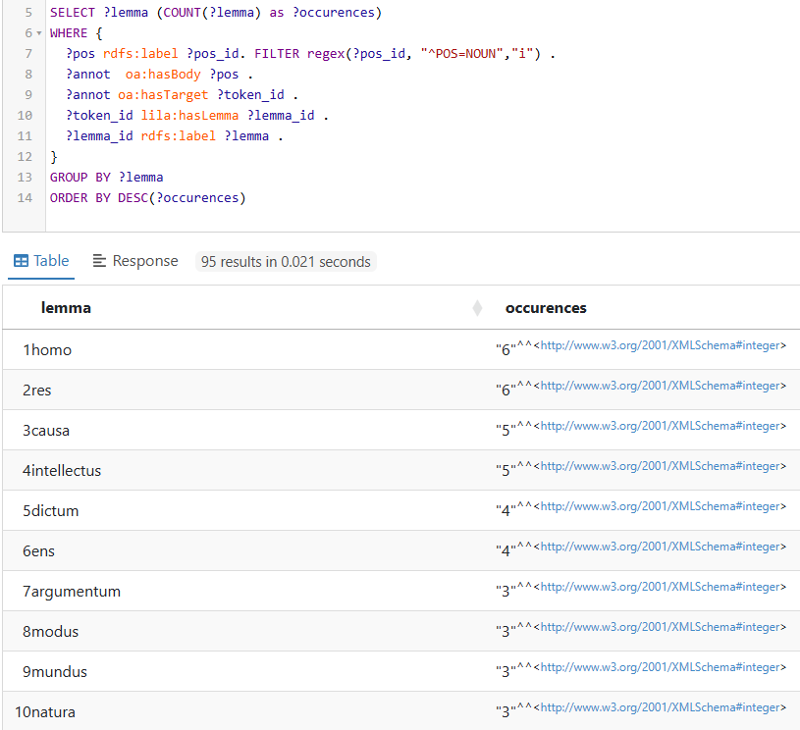
Most frequent POS and most frequent nouns

Slide 34





Team
Name
Title
Name
Title
Name
Title
Name
Title
Name
Title

Slide 35
Timeline
Title
To start a presentation, go to the Slide Show tab, and select From Beginning.
Title
To display Presenter view, in Slide Show view, on the control bar at the bottom left select the three dots, and then Show Presenter View.
Title
During your presentation, the speaker notes are visible on your monitor, but aren't visible to the audience.
Title
The Notes pane is a box that appears below each slide. Tap it to add notes.
Title
If you don’t see the Notes pane or it is completely minimized, click Notes on the task bar across the bottom of the PowerPoint window.

Slide 36
Content
Subtitle
Subtitle
Add text, images, art, and videos.
Add transitions, animations, and motion.
Save to OneDrive, to get to your presentations from your computer, tablet, or phone.
Open the Design Ideas pane for instant slide makeovers.
When we have design ideas, we’ll show them to you right there.

Slide 37
Content
Subtitle
Subtitle
Subtitle
Add text, images, art, and videos.
Add transitions, animations, and motion.
Save to OneDrive, to get to your presentations from your computer, tablet, or phone.
Open the Design Ideas pane for instant slide makeovers.
When we have design ideas, we’ll show them to you right there.
This PowerPoint theme uses its own unique set of colors, fonts, and effects to create the overall look and feel of these slides.
PowerPoint has tons of themes to give your presentation just the right personality.

Slide 38



Summary
With PowerPoint, you can create presentations and share your work with others, wherever they are. Type the text you want here to get started. You can also add images, art, and videos on this template. Save to OneDrive and access your presentations from your computer, tablet, or phone.

Slide 39







Thank you
Presenter name
Email address
Website

